Slide 1
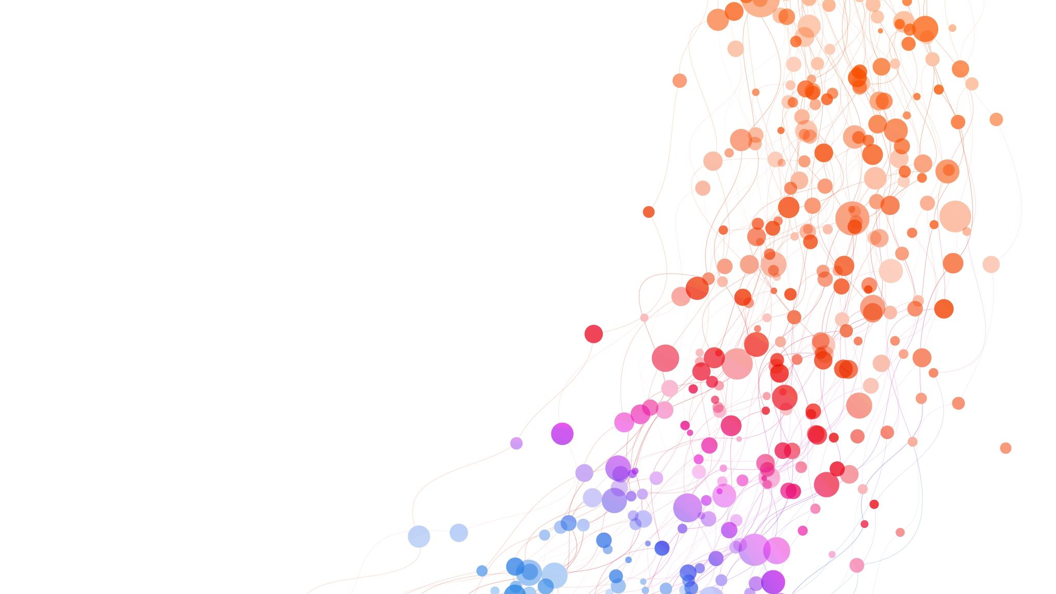
Image Classification with CNN and GradCAM on Flowers102
An End-to-End Deep Learning Project
Name: Thirupathi Peddalla
Date: April 12, 2025
Course: Deep Learning with Pytorch

Slide 2
Table of Contents
Introduction
Dataset Selection & Preprocessing
Model Architecture
Model Training
Evaluation on Validation Data
Fine-Tuning and Iteration
Final Model Testing
GradCAM Visualization
Conclusion

Slide 3
Introduction
Project Objective
Build and train a CNN for classifying images from the Flowers102 dataset.
Robust data preprocessing and augmentation.
Effective model training with early stopping and fine-tuning.
Comprehensive evaluation and model interpretability using GradCAM.
Key Goals:

Slide 4
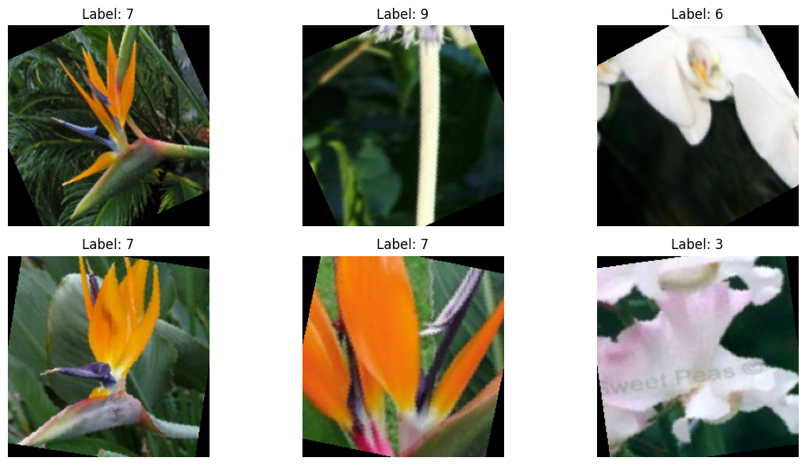
Dataset Selection & Preprocessing
Dataset: Flowers102 (subset: 10 classes selected out of 102)
Preprocessing Steps:
Resize images to 224×224 pixels
Normalize using ImageNet mean (0.485, 0.456, 0.406) and std (0.229, 0.224, 0.225)
Data augmentation (random crop, horizontal flip, rotation) applied for training
Split into training, validation, and test sets
Visual:
sample image showing preprocessed data

Slide 5
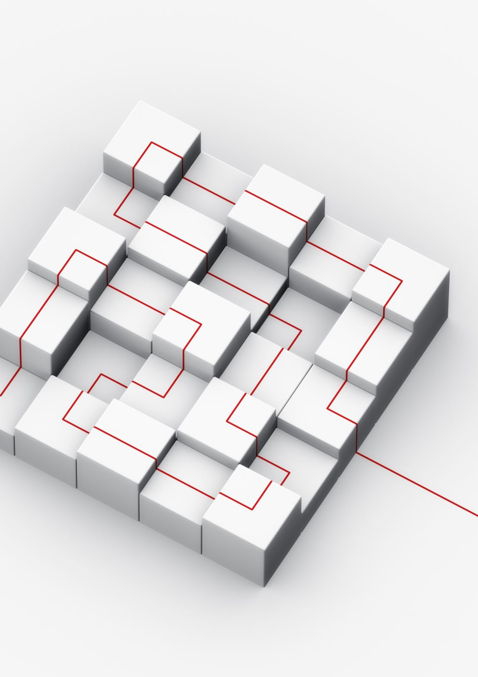
Model Architecture
Custom CNN Design:
Feature Extraction: Four convolutional blocks:
Block 1: Conv (3 → 64) + ReLU + Max Pool
Block 2: Conv (64 → 128) + ReLU + Max Pool
Block 3: Conv (128 → 256) + ReLU + Max Pool
Block 4: Conv (256 → 512) + ReLU + Max Pool
Classifier:
Flatten features and use two fully connected layers with dropout (50% then 30%)
Final fully connected layer outputs predictions for the 10 classes

Slide 6
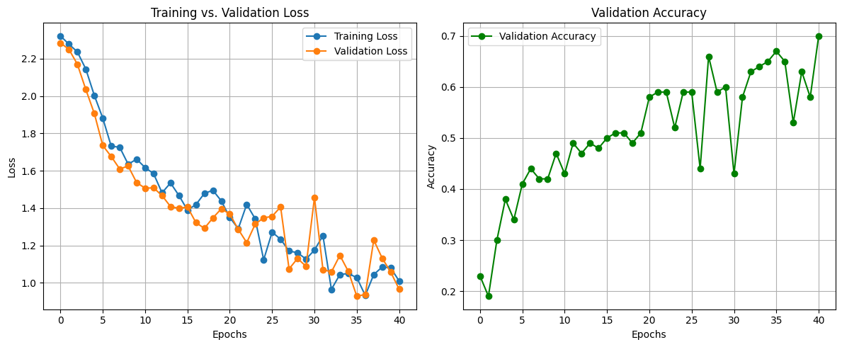
Model Training
Training Setup:
Loss Function: CrossEntropyLoss
Optimizer: Adam
Early Stopping: Monitors validation loss
Training Process:
Epoch-by-epoch training with logging of training loss and accuracy
Validation performed each epoch to track model performance

Slide 7
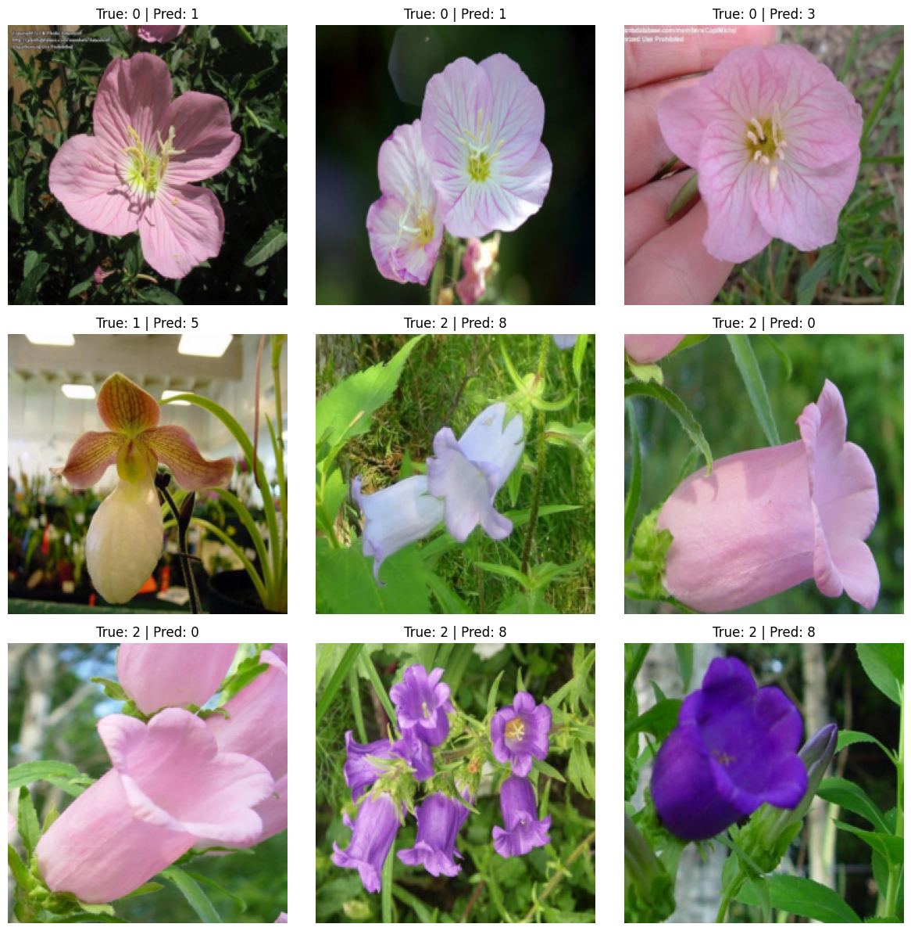
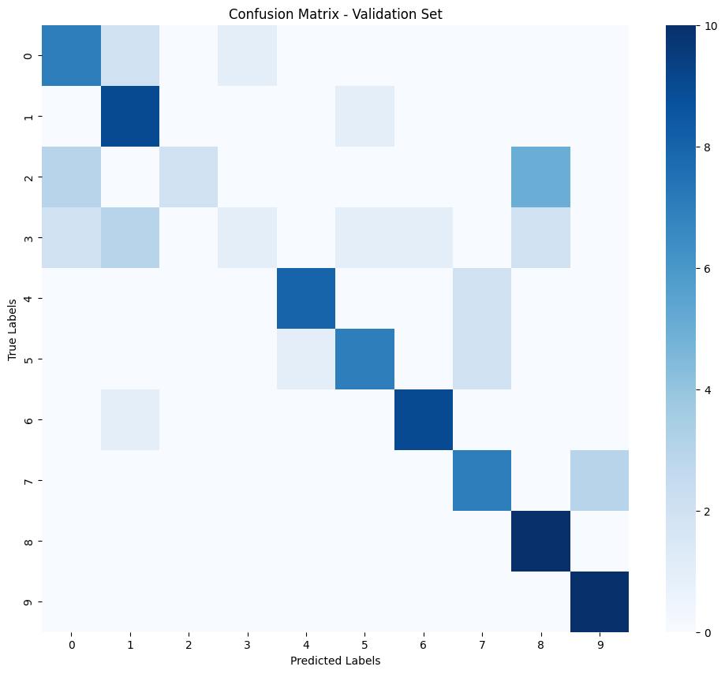
Evaluation on Validation Data
Metrics Calculated:
Accuracy
Precision
Recall
F1-Score
Grid of misclassified examples and Confusion Matrix to show performance per class

Slide 8
Fine-Tuning and Iteration
Techniques Used:
Learning rate scheduler (e.g., ReduceLROnPlateau) to lower the learning rate when improvement stalls
Hyperparameter adjustments (e.g., learning rate, dropout) based on evaluation
Outcome:
Iterative improvements until satisfactory performance is achieved

Slide 9
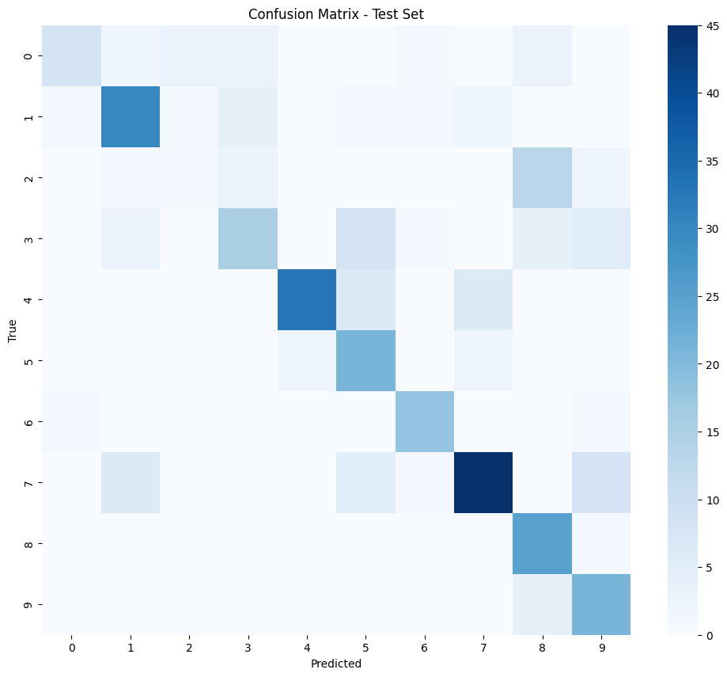
Final Model Testing
Testing Approach:
Evaluate the final, fine-tuned model on the held-out test dataset
Compute test loss, accuracy, and generate a detailed classification report

Slide 10
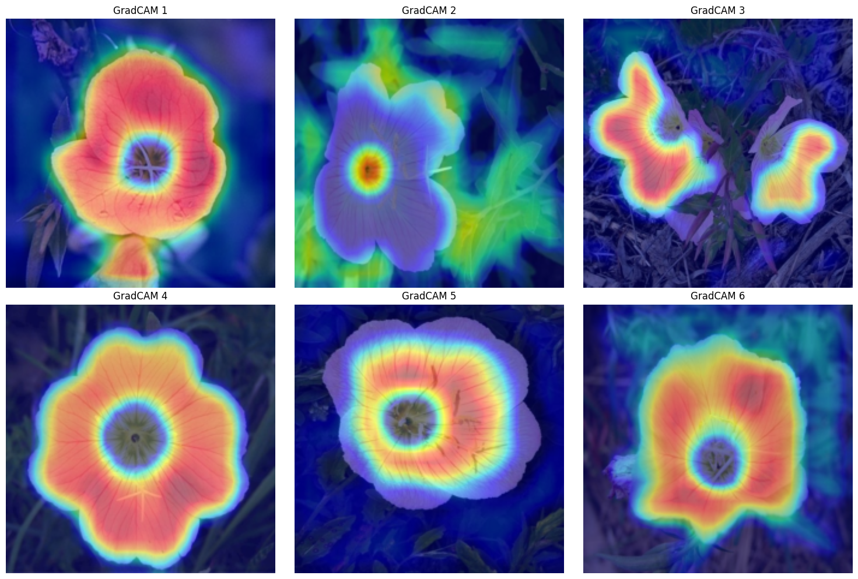
Advanced Visualization with GradCAM
Purpose:
Enhance interpretability by visualizing key regions that influence model predictions
Process:
Implement GradCAM by registering hooks to capture activations and gradients
Compute weighted activations and up sample the generated heatmap to overlay on the input image

Slide 11
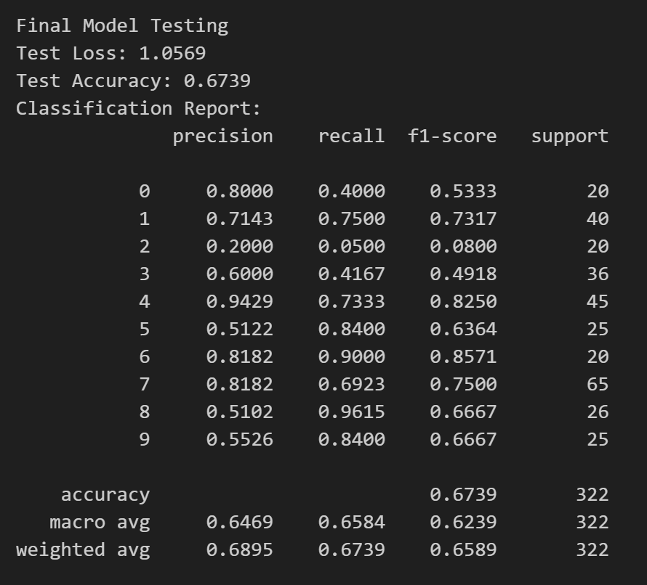
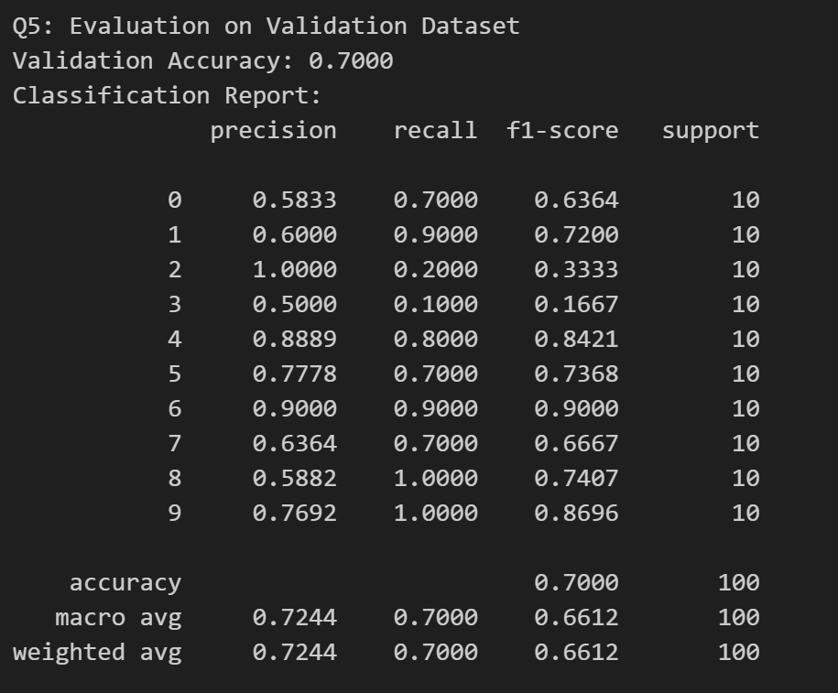
Results
Final Test Results
Test Accuracy: 67.39%
Test Loss: 1.0569
Macro Avg F1-Score: 62.39%
Weighted Avg F1-Score: 65.89%
Validation Results
Validation Accuracy: 70.00%
Macro Avg F1-Score: 66.12%
Weighted Avg F1-Score: 66.12%

Slide 12

Conclusion
Summary:
End-to-end deep learning pipeline implemented successfully
Effective preprocessing, custom CNN design, robust training with early stopping and fine-tuning
Comprehensive evaluation and strong generalization on test data
Advanced interpretability through GradCAM visualization
Future Work:
Experiment with more complex architectures or larger subsets
Extend interpretability techniques further

Slide 13
References
Flowers102 Dataset – Oxford Visual Geometry Group https://www.robots.ox.ac.uk/~vgg/data/flowers/102/
Kaggle – Various Datasets & Competitions https://www.kaggle.com
PyTorch – Deep Learning Framework https://pytorch.org
Grad-CAM: Visual Explanations from Deep Networks via Gradient-Based Localization Selvaraju, R.R., Cogswell, M., Das, A., et al. (2020) International Journal of Computer Vision, 128, 336–359.

